Slide 1

The Smart Gardner
Group 27
Green Core
Notes:
Good Morning everyone, we are group no 27. Our project is Green Core - the smart gardner.

Slide 2
Team
G27
Group Members:
M.M.H Tharushika
H.U.K.M Pabasara
J.A.N.C Niroshana
B.A Medawatta
K.C Gamage
K.S.A Ahamed
17001765
17020611
17001196
17001072
17000475
17020034
Supervisor
Dr Dinuni K Fernando
Co-Supervisor
Ms. Sithara Fernando
Notes:
Our group supervisor is Dr. Dinuni K Fernando and Miss. Sithara Fernando is our co supervisor.
And Hashini, Minura, Nipuna, Binara, Kaviska and I Aathil are our group members.

Slide 3

Green Core - The Smart Gardner
G27
Outline
Introduction
Problem Definition
Goal and Objectives
Project Scope
Deliverables
Functional Requirements
Quality Attributes
Feasibility Study
Proposed Technologies
Project Delivery Timeline
High Level System Architecture
System Development Methodology
Notes:
This is the outline of the presentation.
I’ll present Introduction and problem definition part,
Kavishkaa will present “Goal and objectives, Project Scope and Deliverables”,
after that Hashini will present about “Functional requirements and Quality Attributes”,
As well as Minura will present about feasibility study of the project
and Nipuna will present about Proposed technologies.
And Binara will present the rest of the topics “project delivery timeline, high level system architecture and system development methodology”. [Move to the Next slide]

Slide 4
Green Core - The Smart Gardner
G27
Outline
Introduction
Problem Definition
Goal and Objectives
Project Scope
Deliverables
Functional Requirements
Quality Attributes
Feasibility Study
Proposed Technologies
Project Delivery Timeline
High Level System Architecture
System Development Methodology
Notes:
And first let move on to the problem definition and next to the introduction part.

Slide 5
Problem Definition
G27
People tend to stay at home leisurely for limited time Due to their busy lifestyles.
Gardening with minimum effort is worth and effective.
With the pandemic which occurred in recent past, people tend to grow their own produce for sustainability.
But after this situation people may not have time to take care of their plants due to their busy lifestyle.
Notes:
according to the survey we did among about 160 people,[move to next slide]

Slide 6
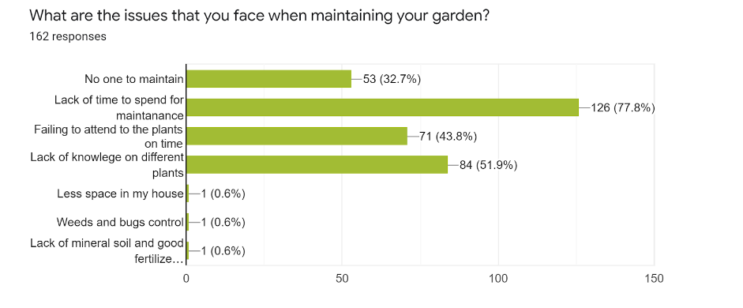
Results of the survey
G27
Notes:
The majority of the people responded that they don’t have that much time for gardening and maintaining the things, and another response was failing to attend to the plants on the time that’s mean due to their busy lifestyle it is very hard to concentrate on the plants. [Move to next slide ]

Slide 7
Problem Definition
G27
People tend to stay at home leisurely for limited time Due to their busy lifestyles.
Gardening with minimum effort is worth and effective.
With the pandemic which occurred in recent past, people tend to grow their own produce for sustainability.
But after this situation people may not have time to take care of their plants due to their busy lifestyle.
Notes:
Usually people tend to stay at home for limited time, due to their busy lifestyle and working schedules. But the pandemic which occured in the recent past, people tend to gardening by themselves for sustainability .
Gardening with minimum effort is worth it.
But after this pandemic, the situation will be totally changed and people may not have time to take care of their gardens as the situations before the pandemic.
We hope “Green Core - The smart gardener” our project will be the suitable solution in these kinds of situations and will be needed.

Slide 8
Introduction
G27
Green-Core is an automated gardening system consists of both manual and automatic gardening features.
Enable users to control their garden while they are away from home by using a smartphone.
Capable of real gardening features such as watering plants.
System consists of an IoT device and a mobile app for the user and a web app to control inner settings.
Notes:
Green core is an automated gardening system.
it consists of both
manual and
2) automatic gardening features,
where Green core enables users of the systems to control the garden it doesn’t matter wherever they are.
And also the system is capable of real gardening features such as
watering plants,
adding fertilizers,
considering growing lights and etc.
Our system consists of IoT device and mobile application for the users.
And a web application for controlling inner settings like admin controls.

Slide 9
Green Core - The Smart Gardner
G27
Outline
Introduction
Problem Definition
Goal and Objectives
Project Scope
Deliverables
Functional Requirements
Quality Attributes
Feasibility Study
Proposed Technologies
Project Delivery Timeline
High Level System Architecture
System Development Methodology
Notes:
from here onwards Kavishkaa will continue
Thank you Athil.

Slide 10

Goal and objectives
G27
Notes:
Now let’s talk about Goal and objectives

Slide 11
Our Goal
G27
Our main goal is to develop a smart garden environment that allows the user to provide a real-time gardening experience via a mobile phone.
Notes:
To make our project a success we need a clear goal.
Our main goal is to develop a smart garden environment that allows the user to provide a real-time gardening experience via a mobile phone.
Green core - the smart gardener will provide you with a new gardening experience that you never had before.

Slide 12
Objectives
G27
People can get fresh vegetables and food from their garden with aid of a mobile application.
Track the progress of each plant's status.
Adjust the growing environment remotely and automatically manage the garden lively.
Get real-time notifications of individual plant status via mobile App.
Administrator can collect, view data of all gardens via web application and use them for identifying vulnerable units and predictions, etc.
Notes:
To achieve our goal we have identify our objectives…
1.People can get fresh vegetables and food from their garden with aid of a mobile application.
2.User Track the progress of each plant's status
3 . user can adjust the growing environment remotely and they can automatically manage the garden lively
4. Get real-time notifications of individual plant status via mobile App.
5. with our web application administrator can collect and view data of all the gardens and use them for identifying vulnerable units.

Slide 13
Project Scope
G27
Notes:
project scope

Slide 14

Project Scope
G27
In Scope
Interactive Mobile app and an IoT device for the users
Web App for the system admin
System will be hosted in cloud
System will be able to operate centrally
Out Scope
Train a machine learning model using the data gathered by the sensors to predict optimal conditions to grow specific plant types.
Generating reports regarding useful analytical data.
Notes:
As for the scope we are going to develop a mobile application and an iot device to monitor user’s garden whenever they want.
.We are developing a web application for system admins.
our system will be hosted in cloud and it will be able to operate centally.
Due to the current time constraints training a machine learning model and generating reports with analytical data is beyond our scope.But if time permits, we hope to develop these features in the future.

Slide 15
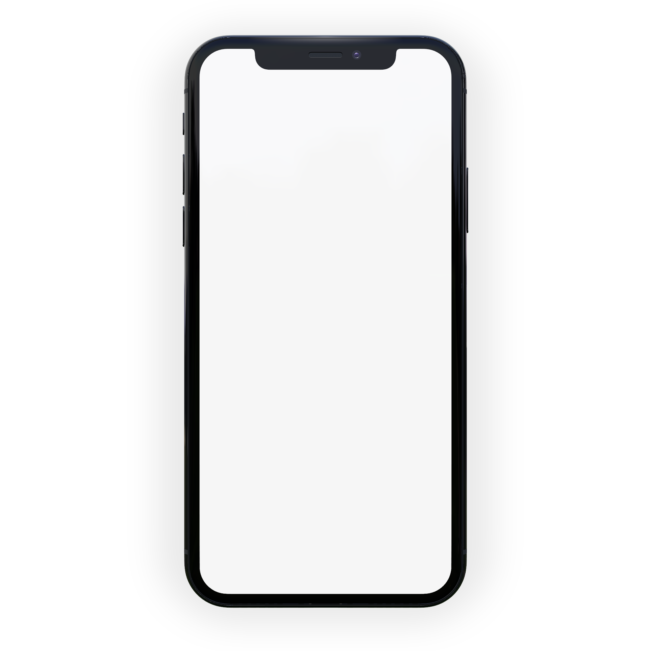
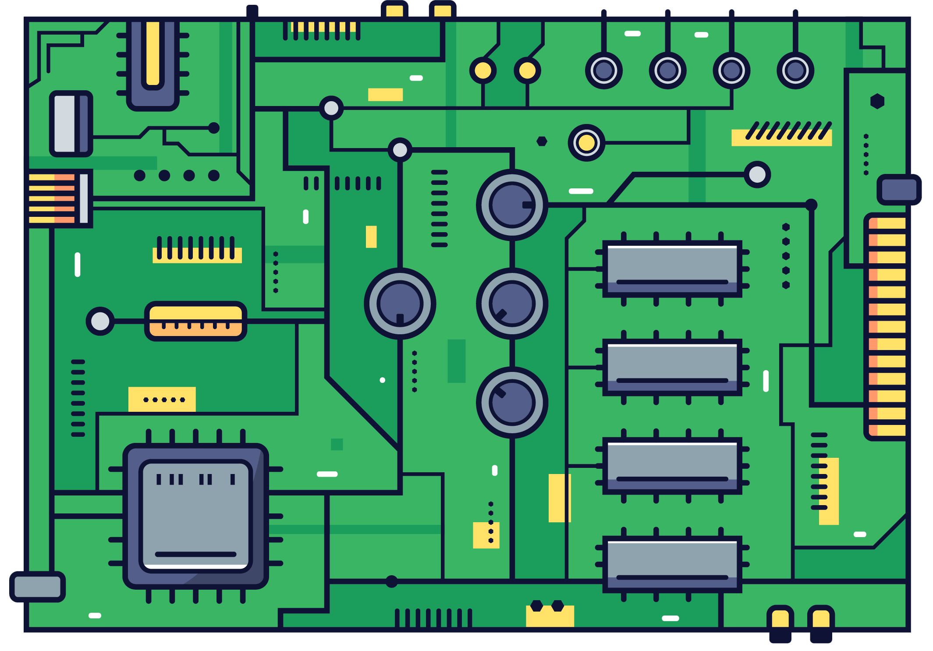

Deliverables
G27
Mobile app
IoT Device
Web App
Notes:
Our main deliverables are , a mobile app that anyone can easily download and install from the playstore ,
an iot device which the user can purchase from the store and a web application for administration purposes.

Slide 16
Use Case Diagrams
G27
Notes:
Now let’s look at our use case diagrams

Slide 17
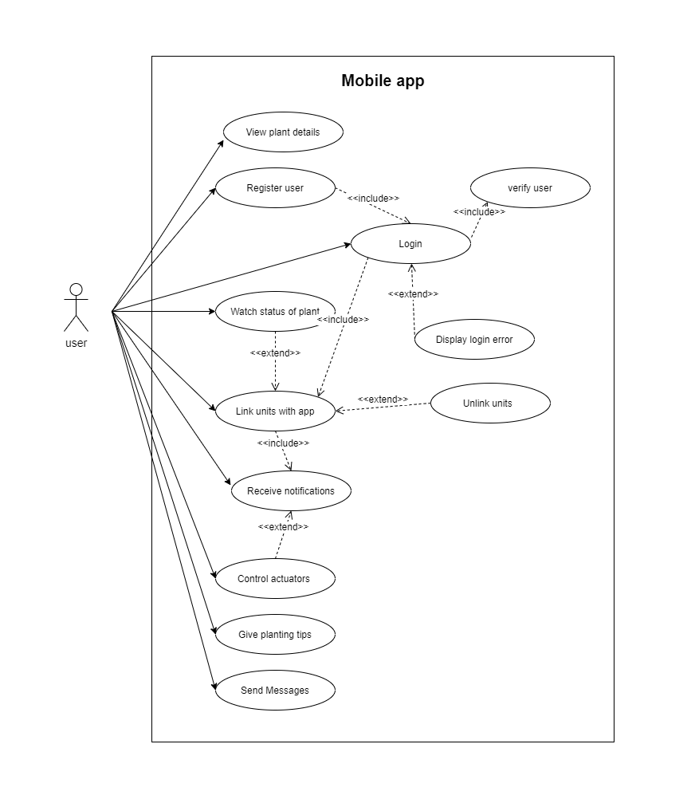
Mobile Application
G27
Notes:
As you can see this is our mobile application use cases
we have one actor who is the user of mobile application
View plant details
register user
login
watch status of plant
link units with app
chat module are some of our use cases

Slide 18
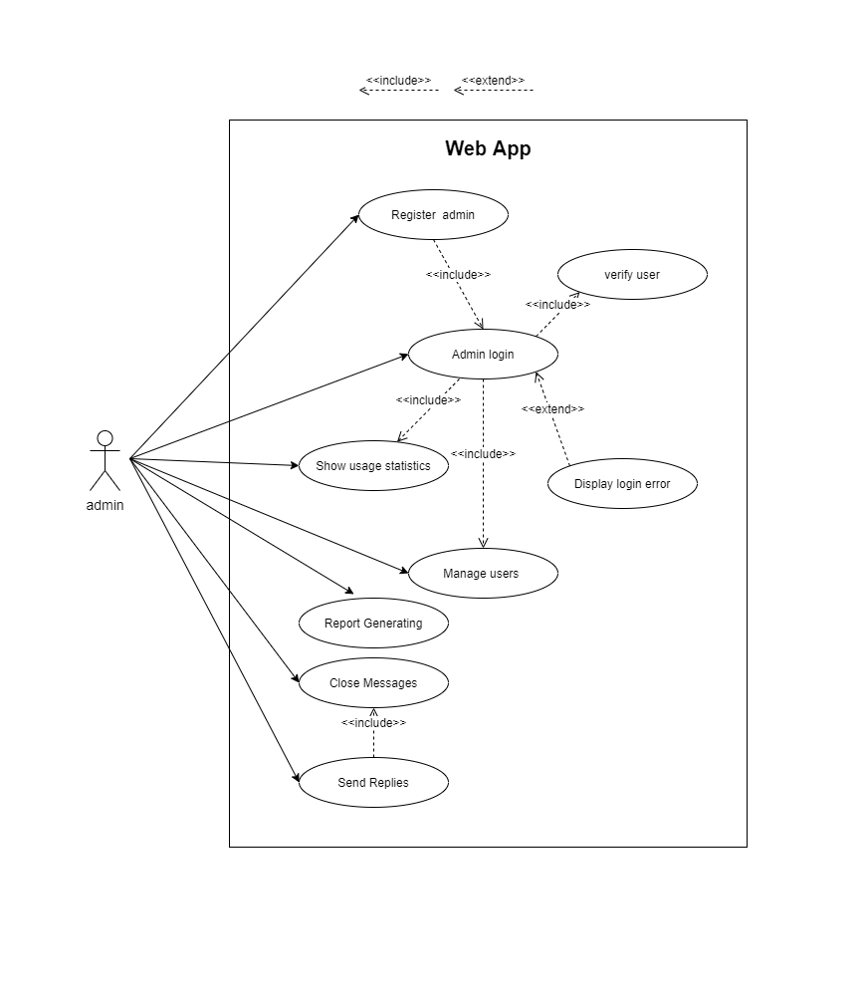
Web Application
G27
Notes:
This is the use case diagram of our web applicaion
here we have one actor who is the admin of web application
Register admin
login admin
show usage statistics
manage users
chat module are some of use cases

Slide 19
Green Core - The Smart Gardner
G27
Outline
Introduction
Problem Definition
Goal and Objectives
Project Scope
Deliverables
Functional Requirements
Quality Attributes
Feasibility Study
Proposed Technologies
Project Delivery Timeline
High Level System Architecture
System Development Methodology
Notes:
from here onwards hasini will continue the presentation

Slide 20
Functional Requirements
G27
Notes:
Thank you Kavishka, Functional Requirements

Slide 21
Mobile Application
G27
User can sign up and log into the mobile application and setup account settings.
Application is able to get feedback of IoT units.
Real time notifications regarding status of the user’s garden.
Able to give planting tips to the user.
User can monitor the garden status.
User can add new units/modules
Users can contact administrators using the inbuilt chat .
Notes:
We have identify functional requirements of our mobile application as…..
User can sign up and log into the mobile application and setup account settings.
Application is able to get feedback of iot units .Some of the sensors we are using are Humidity sensor,Light intensity sensor,servo motors,water level sensor and soil moisture sensor .
Real time notifications regarding status of the user’s garden.
Able to give planting tips to the user.
User can monitor the garden status like water level,nutrition level and light intensity.
User can add new units or modules.
And also users can contact administrators using the inbuilt chat.

Slide 22
Web Application
G27
User(admin) can sign up and log in.
User can update profile details.
View analyzed data(graphs) about gardens.
View local map of all the mobile app users garden location.
Notify about failed or vulnerable units.
Contact users regarding their issues and issues with their IOT devices(Chat Module).
Notes:
Here are the functional requirements in our web application
User,all admins can sign up and log in.
User can update their profile details.
View analyzed data(graphs) about gardens.
View local map of all the mobile app users garden location.
Notify about failed or vulnerable units.
Contact users regarding their issues and issues with their IoT devices thorough Chat Module in the web application.

Slide 23
Quality attributes
G27
Notes:
Now we will consider about the quality attributes.

Slide 24
G27
Availability
System will be available on both mobile and web with any internet accessible device.
Usability
Simple and easy to use interface throughout the mobile and web application.
Dependability
Backups backend database to a database in the cloud
periodically.
Notes:
Availability
System will be available on both mobile and web with any internet accessible device.
Usability
Simple and easy to use interface throughout the Mobile and Web Application.
Dependability
Backups backend database to a database in the cloud periodically.
Backups are made weekly. If we back up daily the cost will be high. If we backup monthly and if there was database failure many users may be affected. So as a sweet spot we chose to backup once a week.

Slide 25
G27
Security
Only administrators can access the web application and
only registered users can enter to the mobile app.
Assumption- Administrator is a trustworthy person.
Maintainability
Mobile app can be updated easily through Playstore.
Repairs on the IoT device can be done easily because of the modular nature of the IOT device.
Notes:
Security
Only administrators can access the web application and
only registered users can enter to the mobile application.
In here we assume as , administrator is a trustworthy person.
Maintainability
Mobile app can be updated easily through Playstore.
Repairs on the IoT device can be done easily because of the modular nature of the IOT device.

Slide 26
Green Core - The Smart Gardner
G27
Outline
Introduction
Problem Definition
Goal and Objectives
Project Scope
Deliverables
Functional Requirements
Quality Attributes
Feasibility Study
Proposed Technologies
Project Delivery Timeline
High Level System Architecture
System Development Methodology
Notes:
from here onwards Minura will continue the presentation.

Slide 27
Feasibility Study
G27
Notes:
Feasibility study that we have conducted for our project

Slide 28
Technical Feasibility
G27
To satisfy our requirements, IoT device ESP8266 and arduino mega is sufficient along with some sensors such as soil moisture, humidity, etc.
We use Amazon Web Server(AWS) which is also available for free for a year to host our virtual servers.
MongoDB , Node.js and Reactjs are Free and Open Source.
Mobile application will run on any tablet or smartphone with proper backups.
Web application will run on all major browsers with proper security features.
Notes:
for the first step
The mentioned ioT device and the arduino mega is sufficient to satisfy requirements.
Virtual servers will be hosted by amazon web server.
All technologies that we use Mongodb, node js and react js are free and open source and
Both the mobile app and the web app will run on any smart device with proper backup and security features.

Slide 29
Operational Feasibility
G27
Both the mobile application and web application will provide simple and intuitive Interfaces to the user.
Web based System so that user can enroll with the system at any time any where.
Almost everyone uses smartphones in their daytoday life so an app is a good way to get notifications about the plantation.
Notes:
Both mobile and web applications will have simple interfaces which will be easy to use.
Also any user will be able to use the web app anytime anywhere.
since everyone use smart devices nowadays, users can get notifications about their plants easily

Slide 30
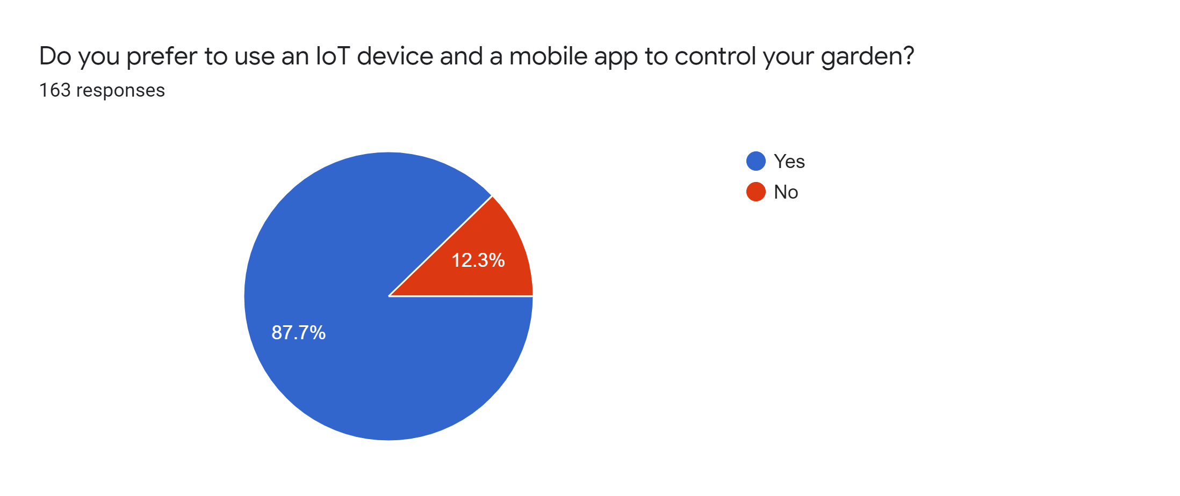
G27

Slide 31
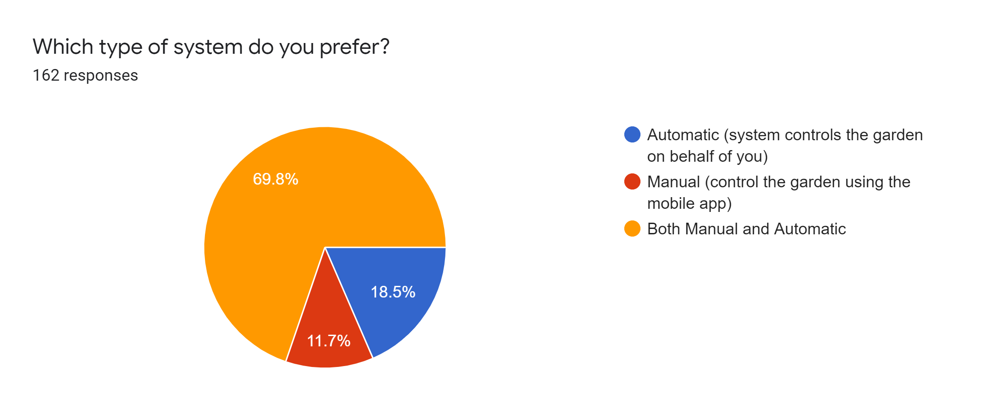
G27

Slide 32
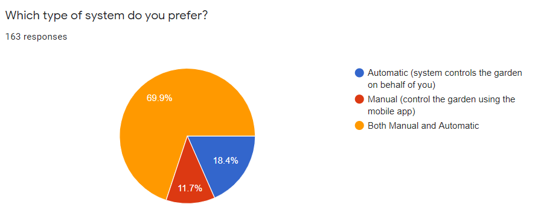
G27

Slide 33
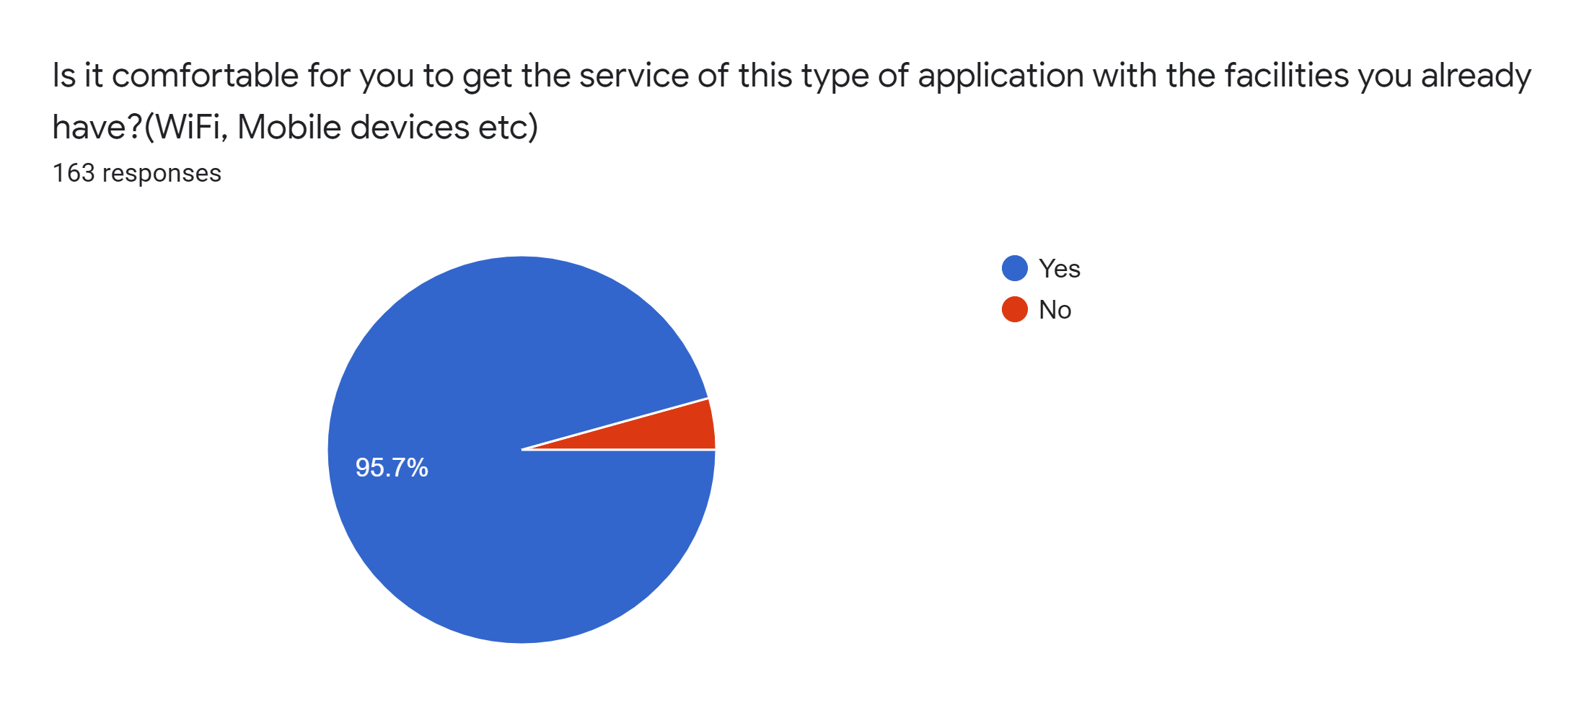
G27

Slide 34
Economic Feasibility
G27
The web application is hosted in the AWS free-tier server, which is provided by AWS for free for one year and this bears zero cost for the first year of operation.
As we use MongoDB for our database which is free and there are 25 Million database operations provided for the free tier.
We develop IoT device using arduino uno and ESP8266 as they are cost effective (cost will be around 20$ per unit)
Since it is developed only by a team of university students, development cost also can be factored as none.
Notes:
. Our web app is hosted in the Amazon WS server which is free for 1 year
all the other technologies we use are free and open source (mongodb, react js )
. The only cost will be for the ioT device which will cost around $20 per unit
As this system is developed by us development cost also can be considered as none.

Slide 35
Schedule Feasibility (Time Estimation )
G27
Number of work hours for a member
○ Weekdays = 3*5
○ Weekends = 4*2
● Man-hours per week = (3*5 + 4*2 )*6= 138
Estimated number of weeks = 13
Estimated total of man hours = 138*13 = 1794
Notes:
As estimated this project will take 13 weeks to complete.
So as mentioned all the team member s will work according to the schedule to complete the project within the allocated time

Slide 36
Legal and Ethical Feasibility
G27
Privacy of information -​ User details and their garden information will not be exposed at any cost.
Handling user data -​ The interest of the user within the system is confidential and will not be sold or used for advertising purposes (AdSense etc.)
User and IoT device location will be recorded only with the consent of the user.
Notes:
for the final step
The private info of the users will be protected.
And User data will not exposed to a third party for any other purposes. Like advertising
And also User have to give the approval for the app to track their location.
Therefore we have decided that this project GreenCore is feasible for all categories above mentioned.
Nipuna will conduct the rest

Slide 37
Green Core - The Smart Gardner
G27
Outline
Introduction
Problem Definition
Goal and Objectives
Project Scope
Deliverables
Functional Requirements
Quality Attributes
Feasibility Study
Proposed Technologies
Project Delivery Timeline
High Level System Architecture
System Development Methodology
Notes:
from here onwards nipuna will continue

Slide 38
Proposed Technologies
G27
Notes:
Thank you Minura . Next we’ll move into proposed technologies

Slide 39

Mobile Application
G27
Easy to learn.
Cross platform mobile apps from a single codebase.
Higher performance .
Component based development.
Native look and feel.
React Native
Notes:
We selected React native to develop the mobile application because,
React Native
is easy to learn than a Native language (Swift or java ),
offer better quality in both Hybrid apps
has native performance
apps could develop using components
has a native look and feel,
so all and all, React Native gives you the experience of having a Native app, without having to develop one

Slide 40
Web Application
G27
UI could segmented into components and write logic accordingly.
Has a shallow learning curve.
Could reuse components.
Syntax is much like HTML with javascript.
React JS
Notes:
For the web application we selected react js since, ReactJS ‘s syntax is easier to get into .
JSX syntax is somewhat similar to html .
We can segment the entire application into components and develop accordingly

Slide 41

Web servers
G27
Easy to scale the applications horizontally as well as vertically.
Higher performance because of non-blocking I/O operations.
Easy to learn because of the use of javascript .
NodeJS with Express JS
Notes:
For the web servers we selected Node js with the express js framework. because, We want to scale up the application as the user base grows.
So we chose node js as our server side language.
Because nodejs has non-blocking IO operations it has a better performance. On top of nodejs, we used expressjs because of the ease of use

Slide 42
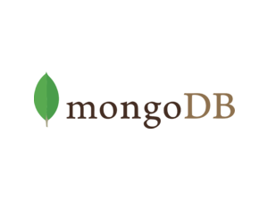
Database
G27
Due to the structuring (BSON format - key value pair) way of the data in MongoDB, no complex joins are needed.
Processing and analyzing big data is easy with NoSQL.
Scalability and Availability requirements for sensor data storage.
Easy to scale up when the system grows (long term).
Clustering - can have different clusters for different regions (long term).
MongoDB (NoSQL)
Notes:
Because of the amount of data we are dealing with, we wanted a DBMS which can scale both horizontally and vertically.
So we chose NoSQL over RDBMS
As we are storing data as documents we wanted a document-based NoSQL datastore so the choice was MongoDB

Slide 43
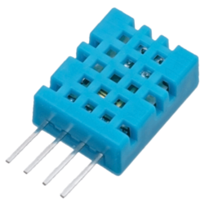
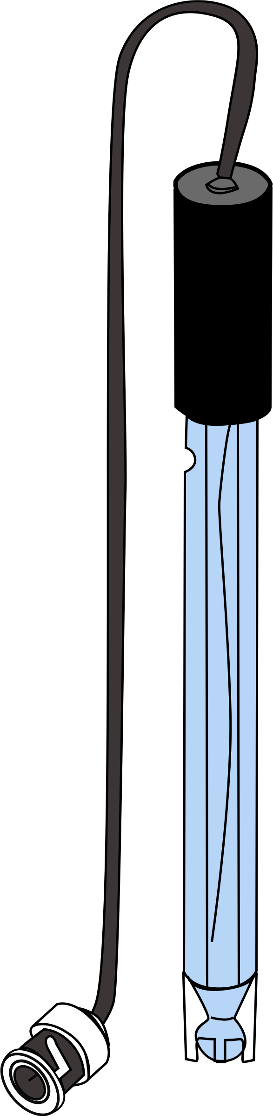
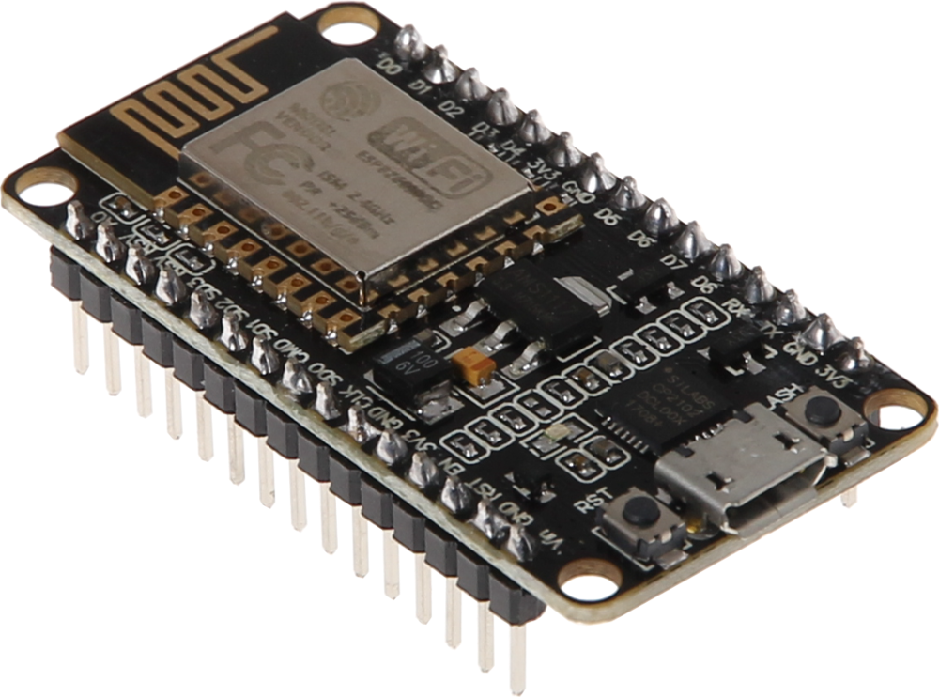
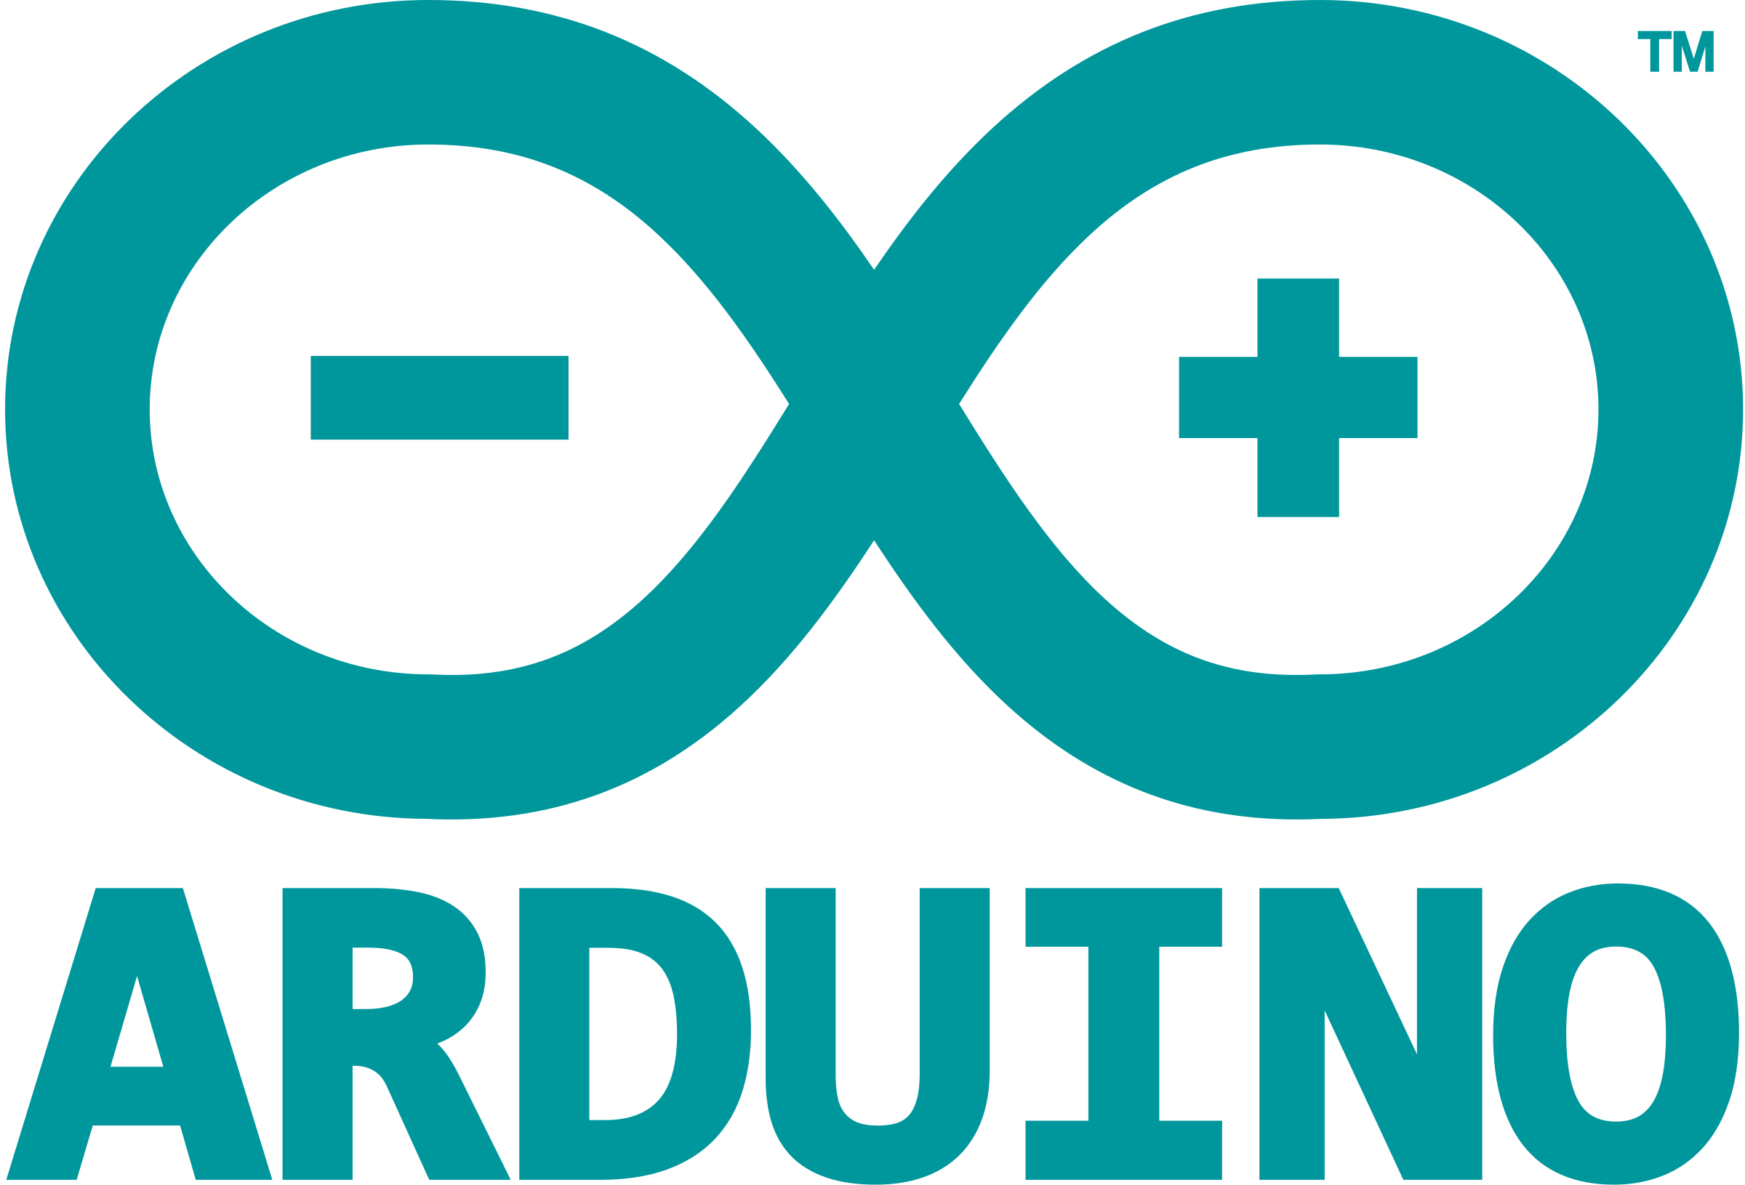
IoT device
G27
Production cost is low. we can print our own Arduino board by customising according to the requirement.
Arduino is open source.
Documentation is available for free.
Arduino Mega and ESP8266
Notes:
As we want this unit’s price to be lesser while having all the functionality we need We’ve chosen Arduino Mega and ESP8266.
Arduino is an open-source platform and has a rich documentation
from here onwards Binara will continue the presentation

Slide 44

Green Core - The Smart Gardner
G27
Outline
Introduction
Problem Definition
Goal and Objectives
Project Scope
Deliverables
Functional Requirements
Quality Attributes
Feasibility Study
Proposed Technologies
Project Delivery Timeline
High Level System Architecture
System Development Methodology
Notes:
from here onwards binara will continue

Slide 45
Project Delivery Timeline
G27
Notes:
When it comes to project delivery

Slide 46
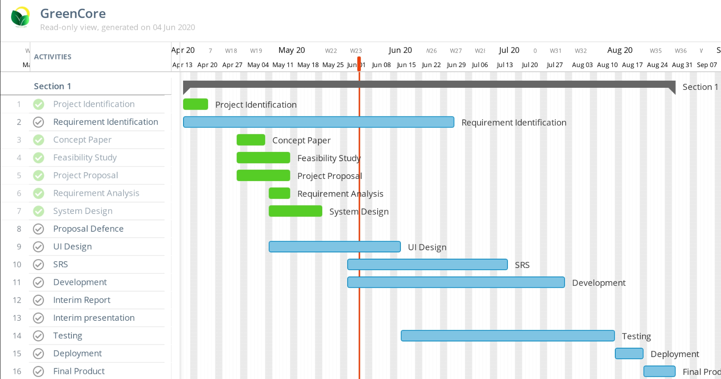
Project Delivery Timeline
G27
Notes:
We have planned to complete the project by the end of August 2nd week
And we have completed the requirement identification, analysis and system design stages
and currently we are in the development stage.
Since we are practicing agile the SRS and Testing is done along with the development
And we have planned to deploy our system by the end of August.

Slide 47
High Level System Architecture
G27

Slide 48
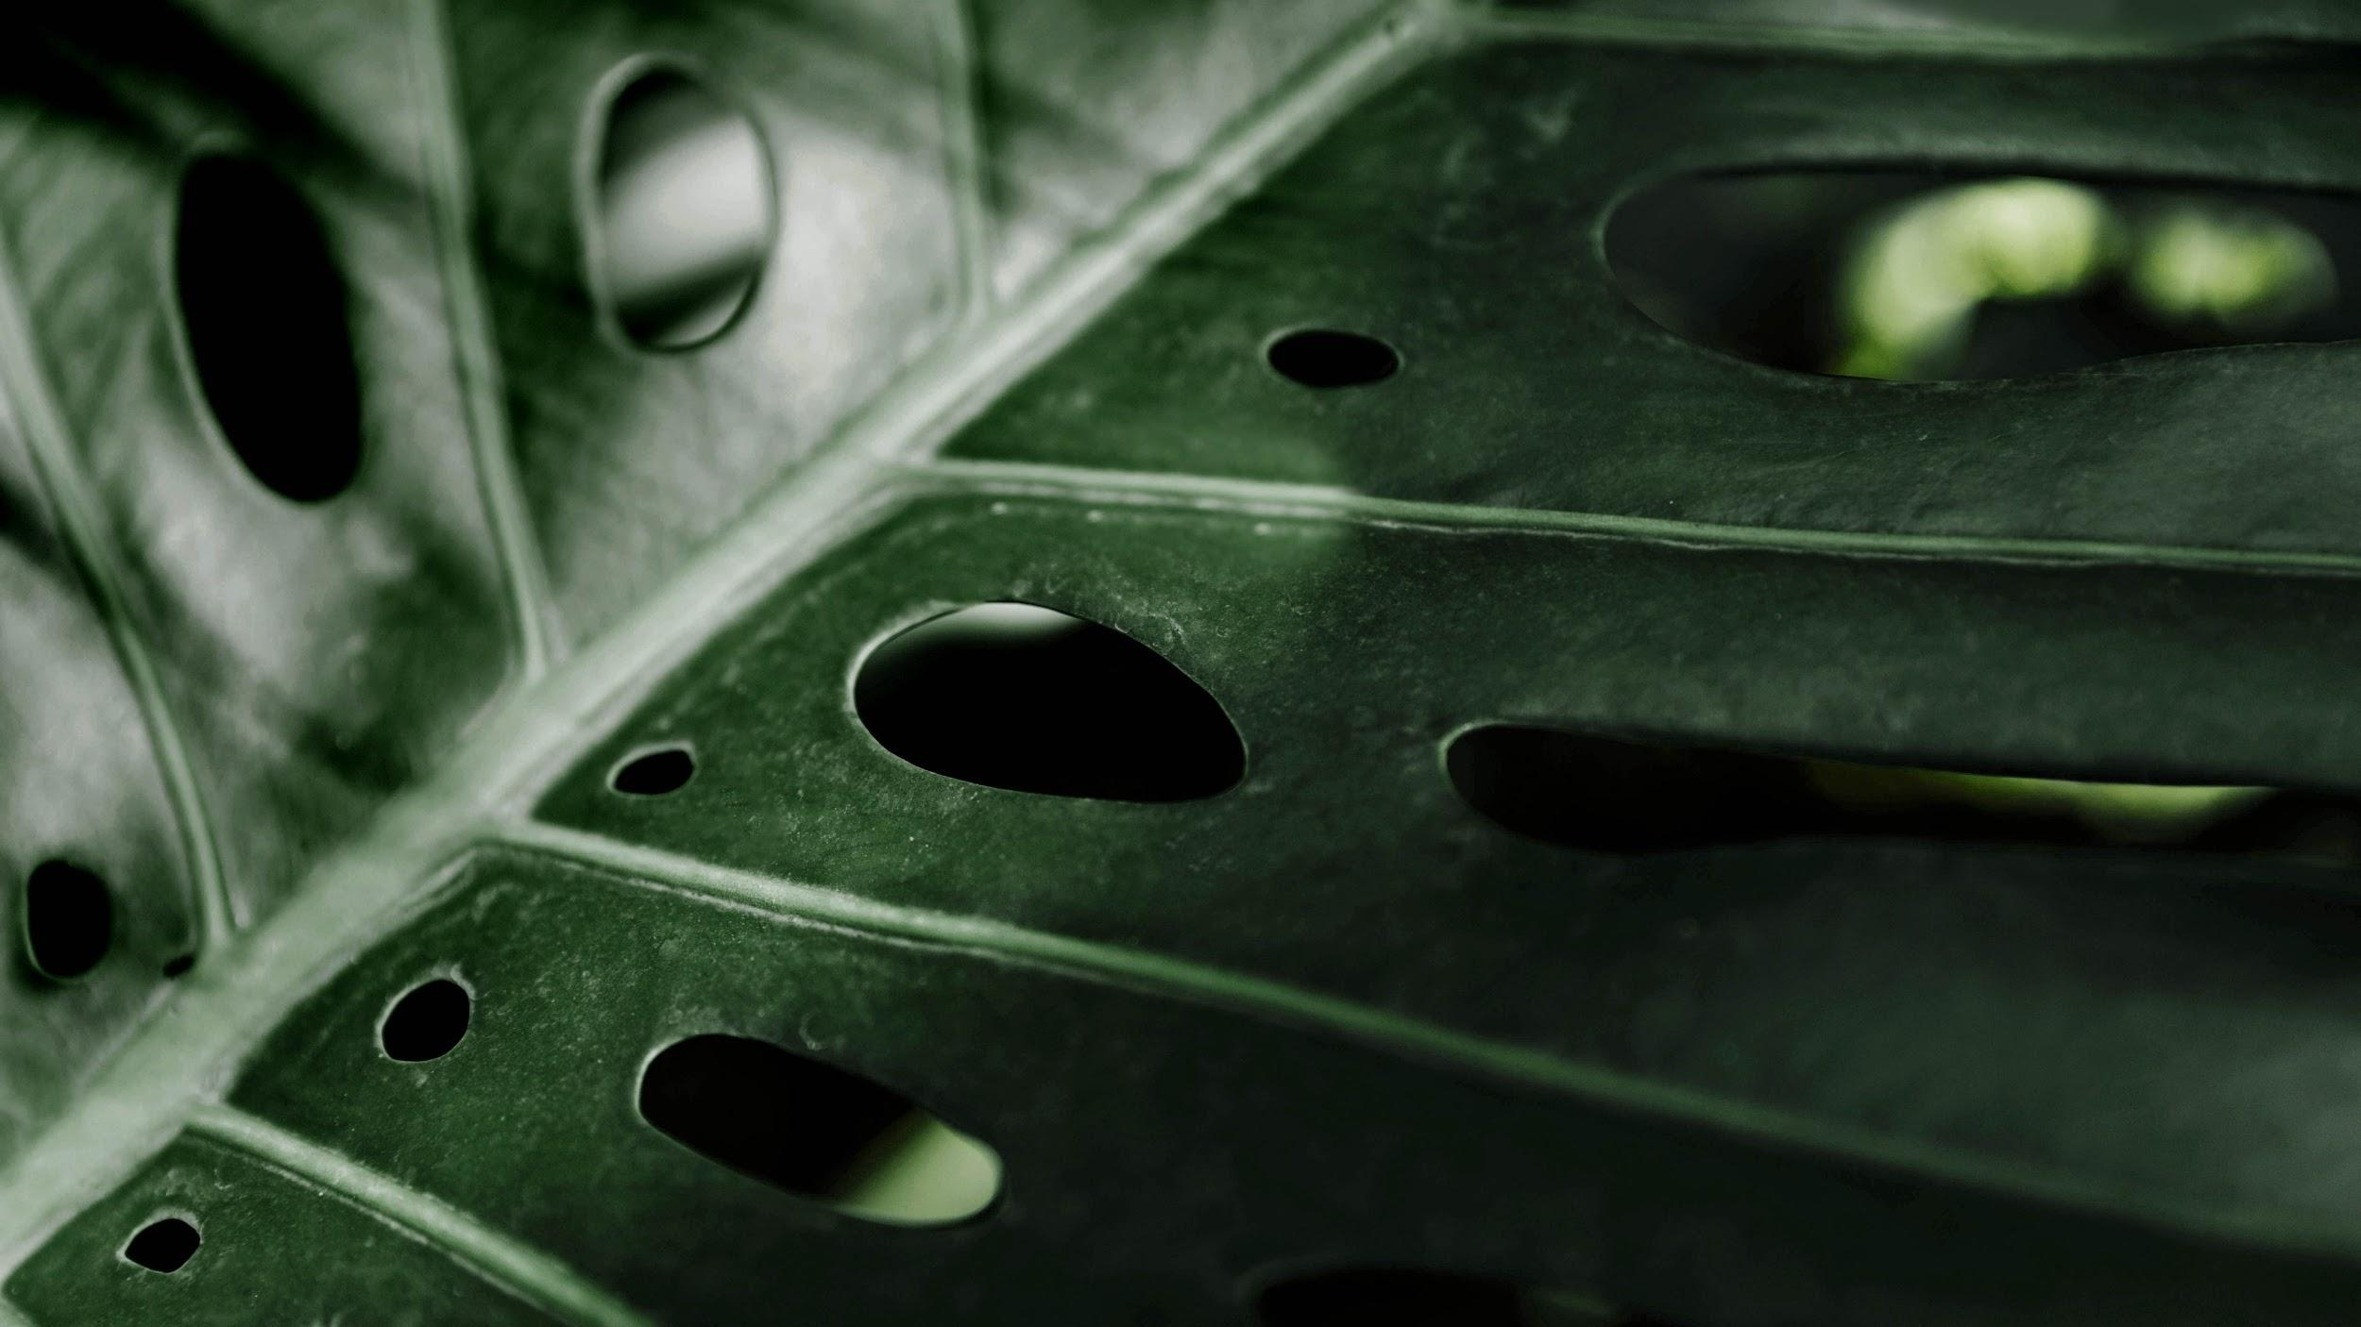


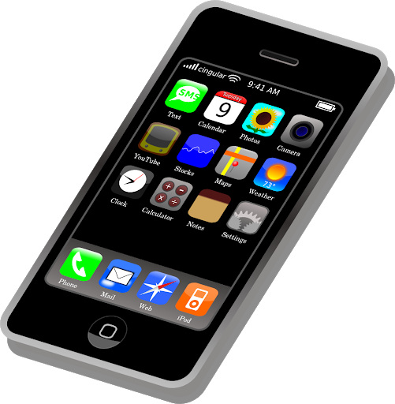
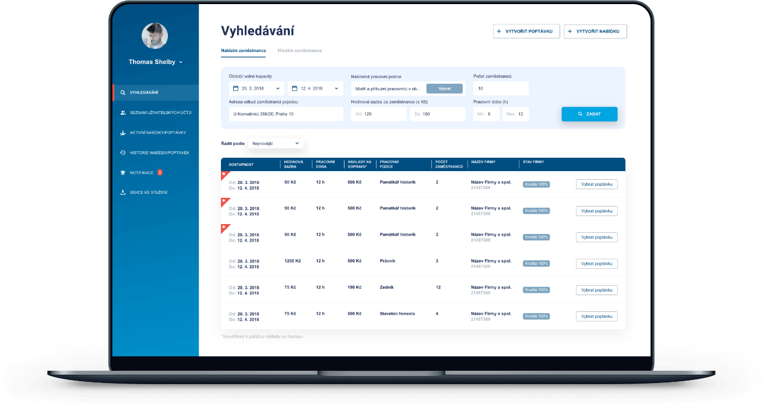
G27
Database
Web server
Web server
Web server
IoT device
Web app
Mobile app
Notes:
Our system consists of a central database to which the mobile app, web app and the iot device will be connected using independent servers.
Communication between the apps, devices and the servers are done via API calls.
The IoT Device will collect data from the sensors and pass it to the database. The web app and the mobile app can retrieve data from the database. All the functions carried out by the user with the IoT device will be first updated in the database and then the action will be carried out in the IoT device.

Slide 49
System Development Methodology & Project Management
G27

Slide 50

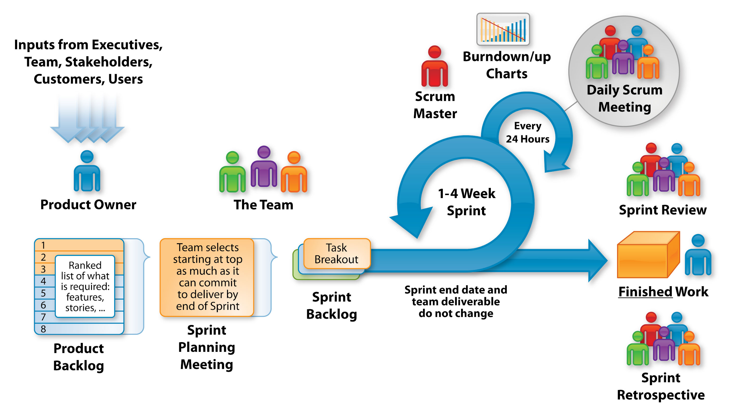
G27
Notes:
We are developing the system according to agile scrum methodology and we work on one week sprints, which includes development work of both the mobile app and the web app. Since we are working on both the web and mobile app at the same time, we have two separate backlogs for each. We are having daily standup meetings via a whatsapp group and by the end of the sprint we are having a sprint review, retrospective and a sprint planning meeting. and currently we are in our 3rd sprint
We selected scrum because,
our system has changing requirements
Active team and client interaction is needed
We’re a cross functional team
Since the team is working remotely it’s easy to manage the backlog and track individual progress

Slide 51
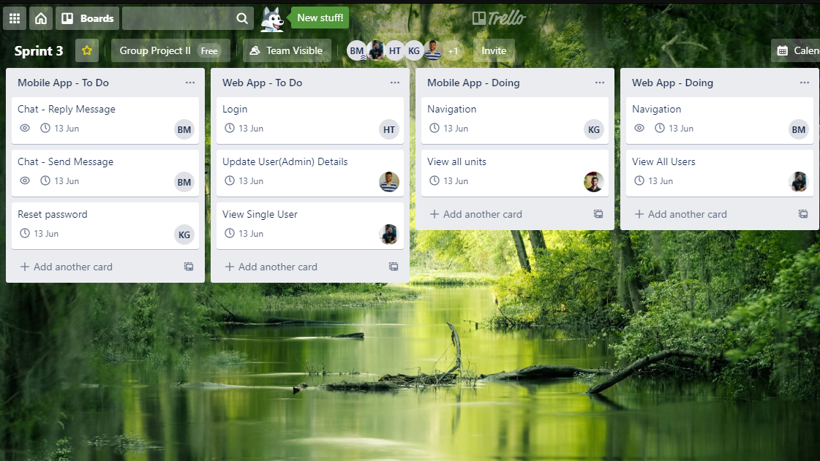
Notes:
We are using Trello to manage our project work and this is our current sprint plan.

Slide 52
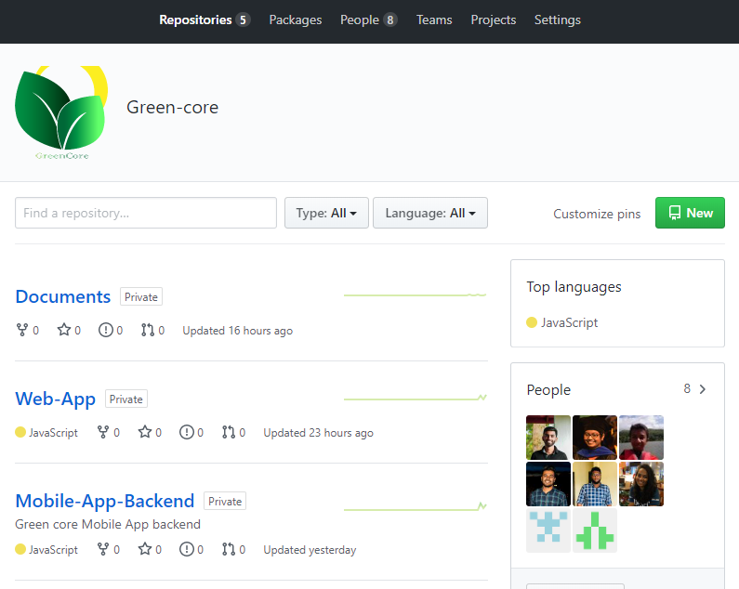

Notes:
We are using GitHub for version controlling and we have created a private organization in GitHub to manage our repositories
By now we have 5 repositories, one for documents, two for the backend and frontend of the mobile app and other two for the backend and frontend of the web app.

Slide 53

Thank You
G27
Notes:
Thank you, we are happy to take any questions.

Slide 54
Any Questions ?
G27
Notes:
Thank you, we are happy to take any questions.

